Slide 1
Social Network Analysis IS 324
February 6, 2024
Jaihyun Park

Slide 2
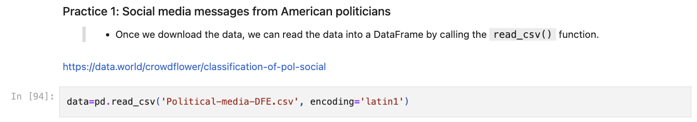
Recap Pandas with the Practice solution

Slide 3
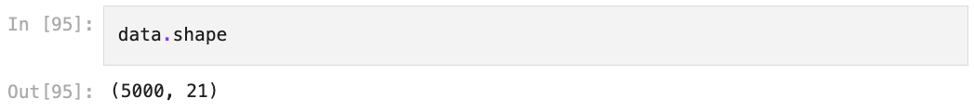
Recap Pandas
(The number of rows, the number of columns)

Slide 4
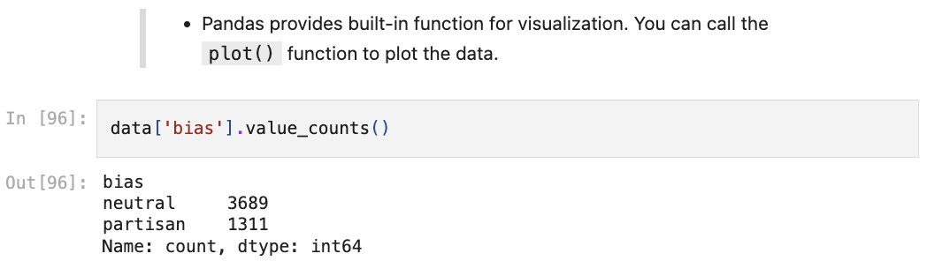
Recap Pandas

Slide 5
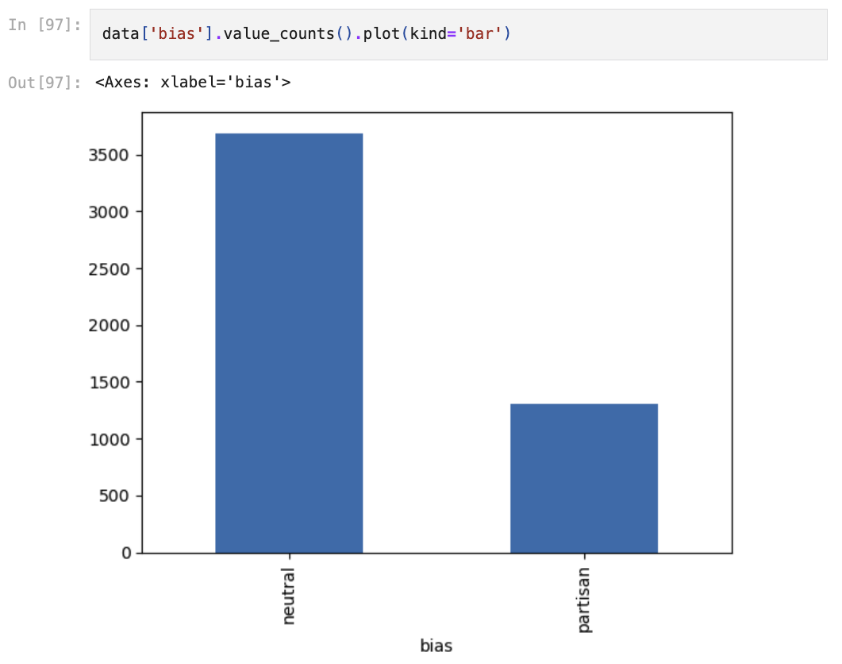
Recap Pandas

Slide 6
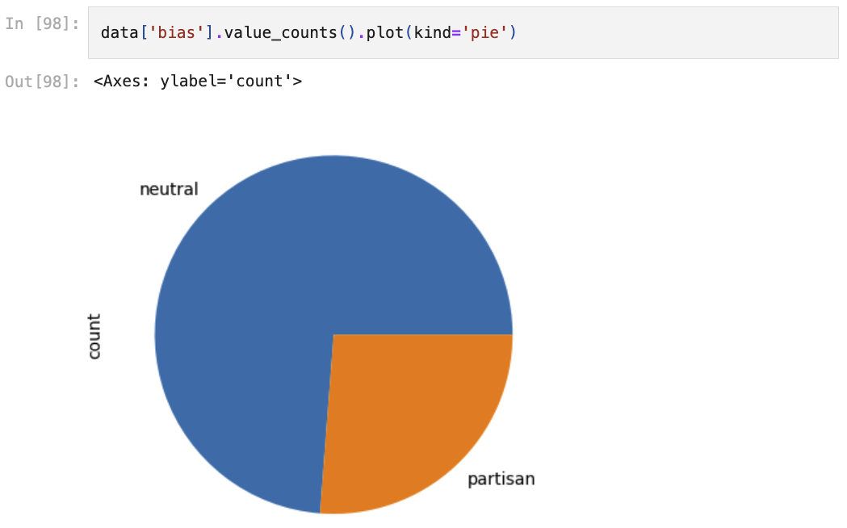
Recap Pandas

Slide 7
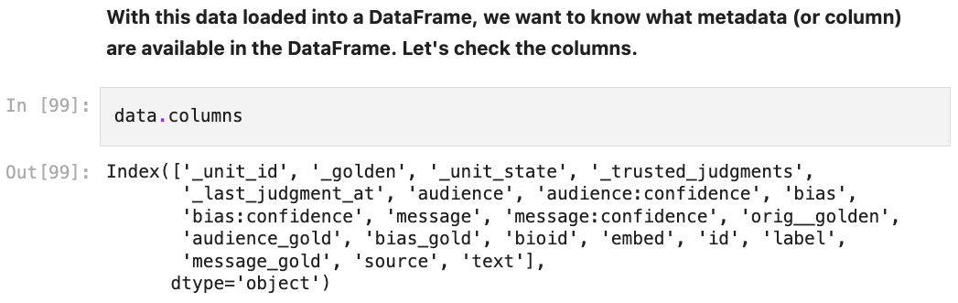
Recap Pandas

Slide 8
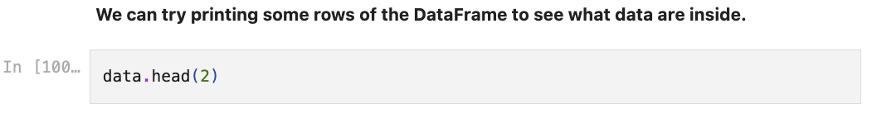
Recap Pandas

Slide 9
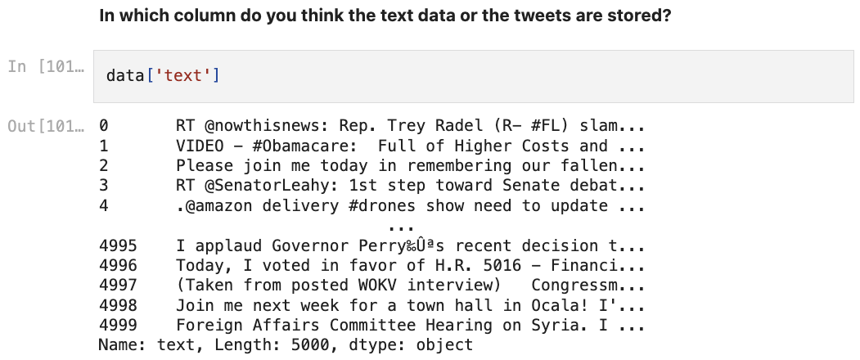
Recap Pandas

Slide 10
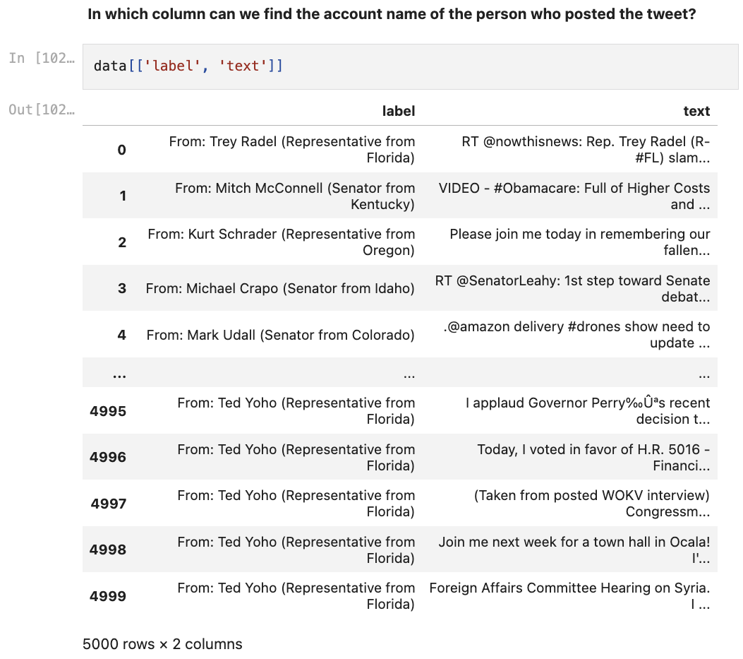
Recap Pandas

Slide 11
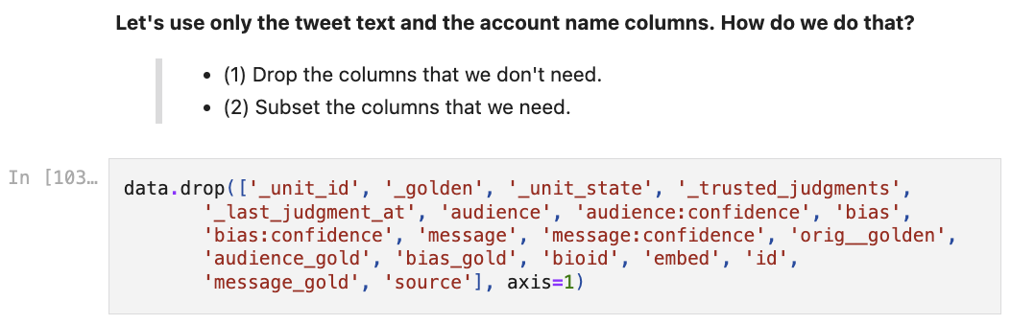
Recap Pandas

Slide 12
Recap Pandas
The second way to subset the data is to use the list of column names and put it in a bracket.

Slide 13
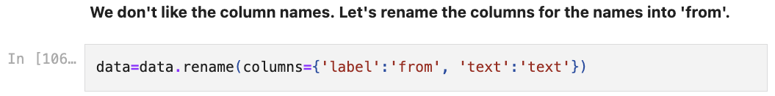
Recap Pandas

Slide 14
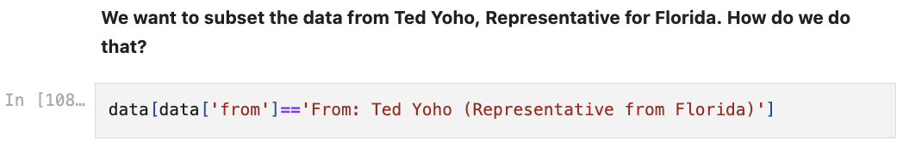
Recap Pandas

Slide 15
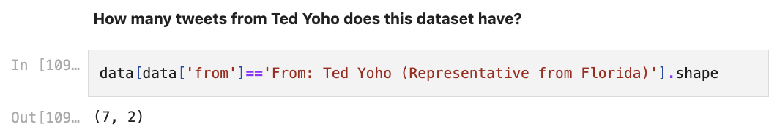
Recap Pandas

Slide 16
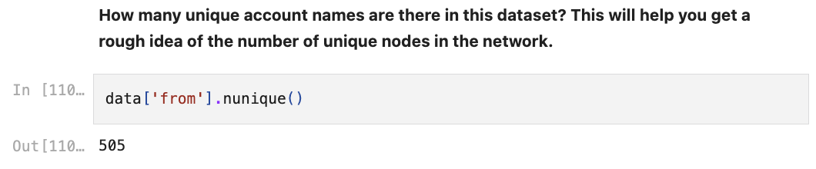
Recap Pandas

Slide 17
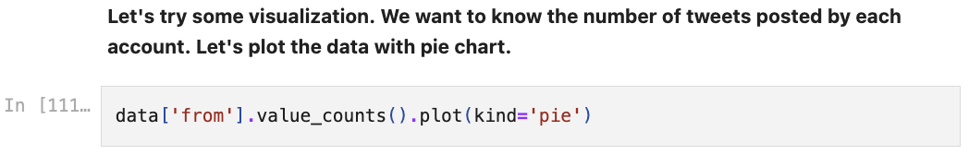
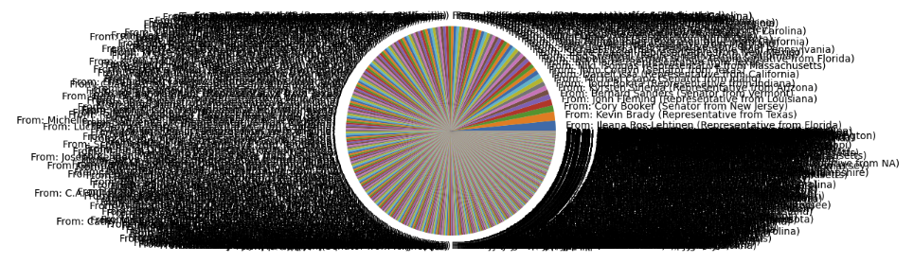
Recap Pandas

Slide 18
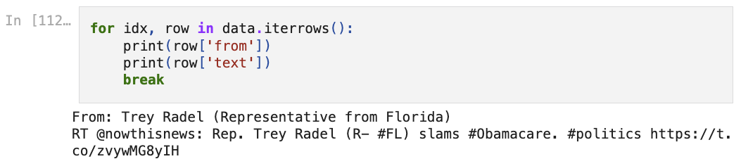
Recap Pandas

Slide 19
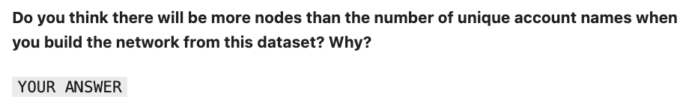
Recap Pandas

Slide 20
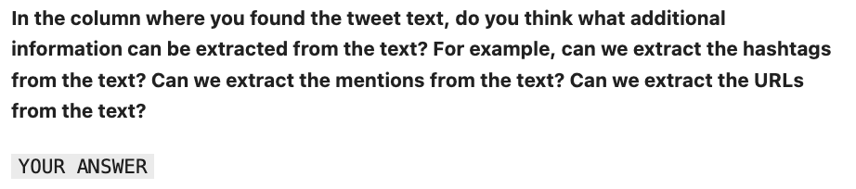
Recap Pandas

Slide 21
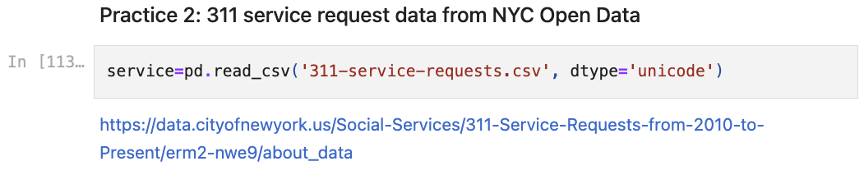
Recap Pandas

Slide 22
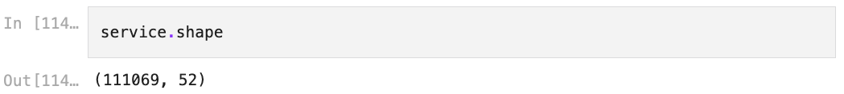
Recap Pandas
(The number of rows, the number of columns)

Slide 23
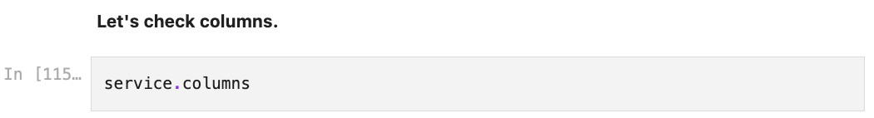
Recap Pandas

Slide 24
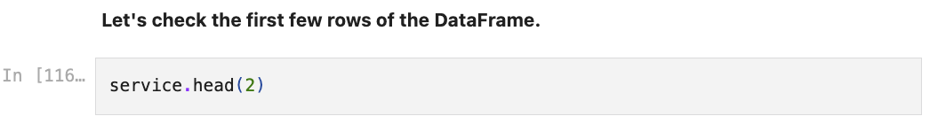
Recap Pandas

Slide 25
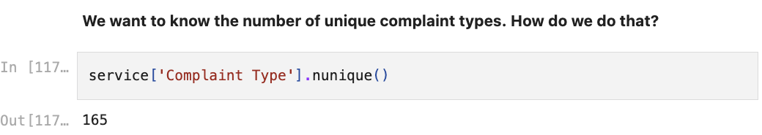
Recap Pandas

Slide 26
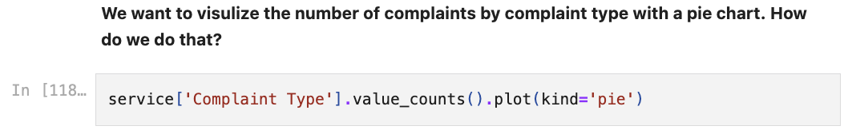
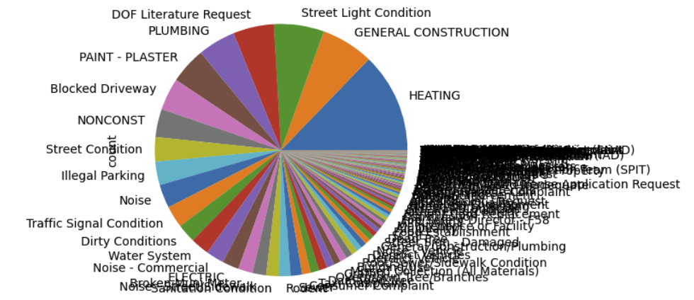
Recap Pandas

Slide 27
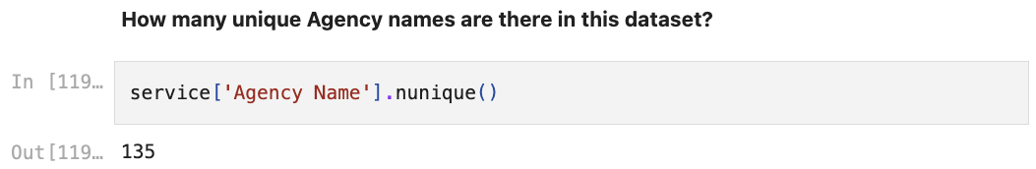
Recap Pandas

Slide 28
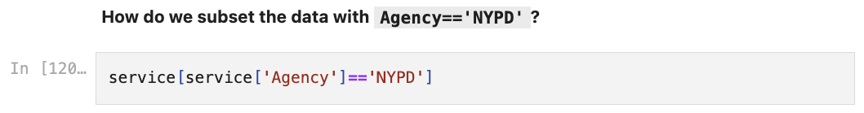
Recap Pandas

Slide 29
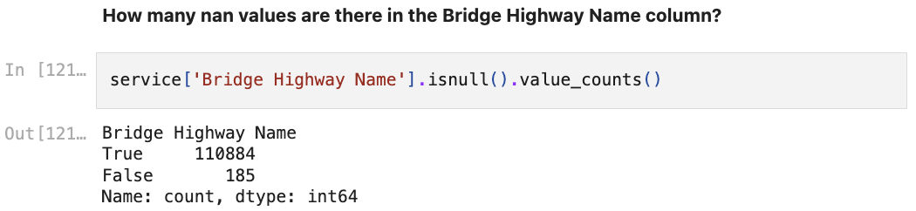
Recap Pandas

Slide 30
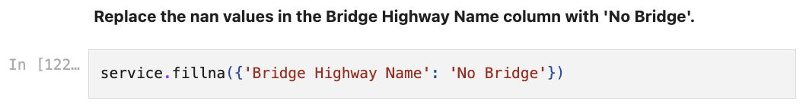
Recap Pandas

Slide 31
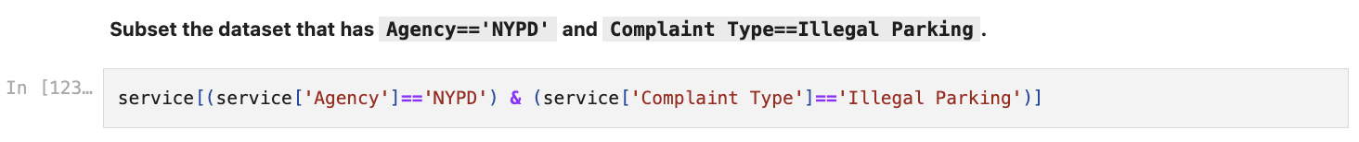
Recap Pandas

Slide 32
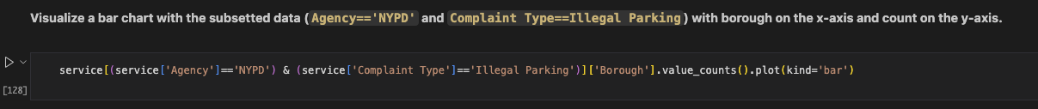
Recap Pandas

Slide 33
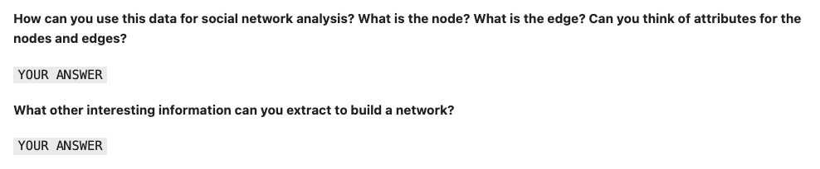
Recap Pandas

Slide 34
Text analysis
We saw some data are the text and we can extract (1) retweets, (2) mentions, and (3) URLs from the text.
Once we identify who they talked to, we can find nodes and build edges between them.
We can also find what they talked about with text analysis.

Slide 35
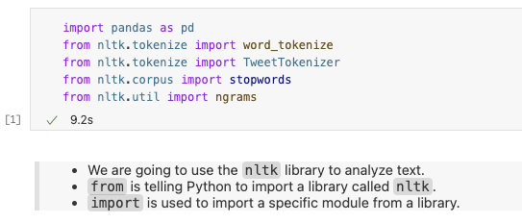
NLTK

Slide 36
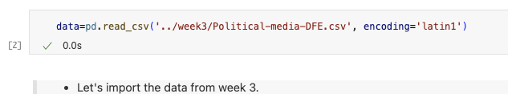
NLTK

Slide 37
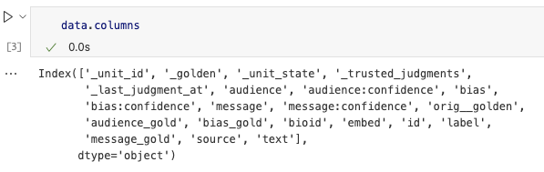
NLTK

Slide 38
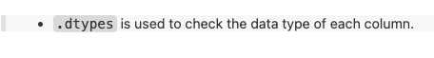
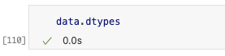
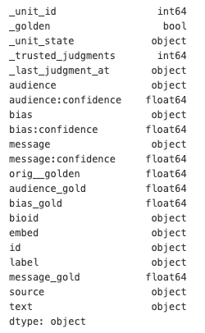
NLTK

Slide 39
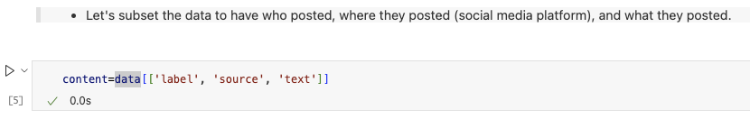
NLTK

Slide 40
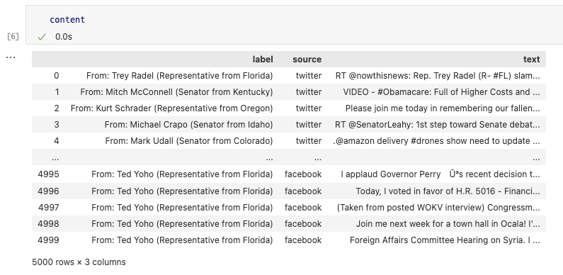
NLTK

Slide 41
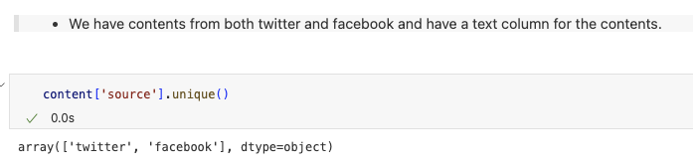
NLTK

Slide 42
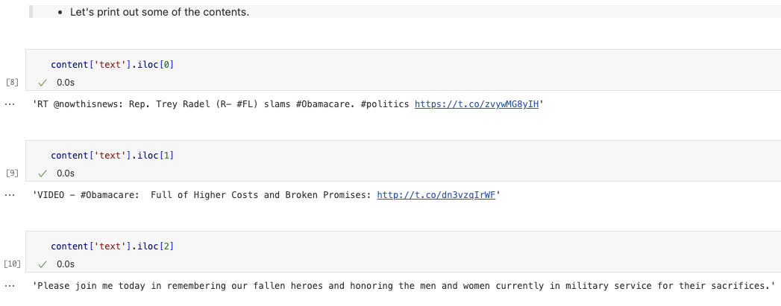
NLTK
Q. What additional type of information can we extract from these tweets?

Slide 43
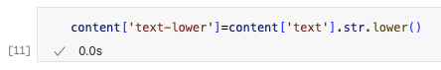
NLTK
In text analysis, it is important to make the text uniform (making them lowercase)

Slide 44
NLTK

Slide 45
NLTK
We can separate the entire text into tokens (words, hashtags, mentions, etc.).
Separating the text into tokens is called tokenization.
We can use word_tokenize function from the nltk library to tokenize the text.
There is also a TweetTokenizer function in the nltk library that is specifically for tweets.

Slide 46
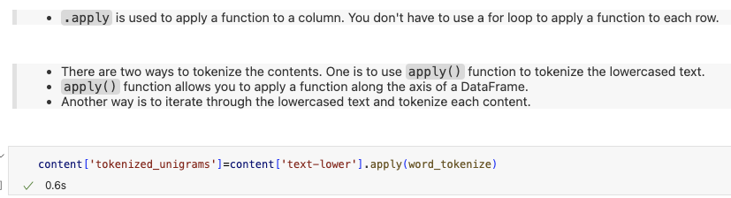
NLTK

Slide 47
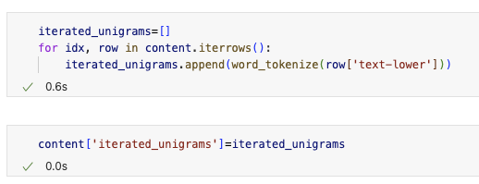
NLTK
There is another way to do tokenization. Instead of using apply() function, we can iterate the DataFrame and put the tokenized results in the list and we can use that list for the value in the column.

Slide 48
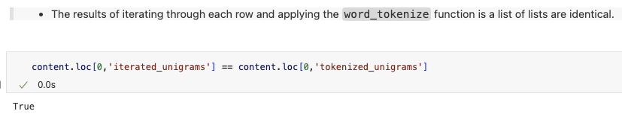
NLTK

Slide 49
N-grams
One token is called a unigram.
(e.g., ‘one’, ‘token’, ‘is’, ‘called’, ‘a’, ‘unigram’.)
We can try to find bigrams (two tokens) and trigrams (three tokens) as well.
(e.g., (‘one’, ‘token’), (‘token’, ’is’), (‘is’, ‘called’)’, (’called’, ‘a’), (‘a’ ‘unigram’))
All of these tokens are called n-grams.

Slide 50
Lambda
Lambda function is an anonymous and inline function.
lambda arguments: expression
(e.g., lambda x: x+1)

Slide 51
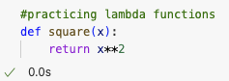
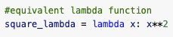
Practicing Lambda

Slide 52
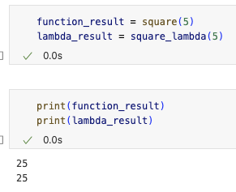
Practicing Lambda
The result of the lambda function and regular function are same

Slide 53

Bigrams
Another way to have bigrams is to iterate the DataFrame, instead of using the lambda function.

Slide 54

Bigrams

Slide 55


Unigram and bigram

Slide 56

Frequent unigrams

Slide 57

Frequent bigrams

Slide 58
Frequent unigrams and bigrams
Q. What do you see as the problem from this result?

Slide 59

Stopwords
In the nltk library, there is a list of stopwords (function words) that we can use to remove from the text.

Slide 60

Stopwords

Slide 61

Stopwords

Slide 62
Stopwords

Slide 63


Stopwords

Slide 64
Unigram after removing stopwords

Slide 65
Bigram after removing stopwords

Slide 66


Frequent unigrams and bigrams after removing stopwords
Q. Are we satisfied with the results?

Slide 67
Removing punctuations

Slide 68

Removing punctuations
Another way to remove punctuation is to iterate the DataFrame

Slide 69


Frequent unigrams and bigrams after removing stopwords and punctuations.

Slide 70
Lemmatization
But we want to do additional cleaning.
When counting the most frequent words, past and present tenses of the same word are counted as different words.
(e.g., ‘run’ and ‘ran’ are counted as different words.
We can use lemmatization to convert words to their base form.

Slide 71

Lemmatization

Slide 72
Lemmatization

Slide 73

Lemmatization
Q. Do you see any different results? What tokens have changed after lemmatization?

Slide 74
Lemmatization
Q. Do you see any different results? What tokens have changed after lemmatization?

Slide 75

Lemmatization
Interestingly enough, NLTK’s WordNetLemmatizer needs POS (Part of Speech) for each token.
Nouns can be lemmatized without POS.

Slide 76


Lemmatization

Slide 77
Lemmatization

Slide 78

Lemmatization

Slide 79
Regular Expression (RegEx)
Let’s extract hashtags and mentions from the text.
We have to use regular expressions to extract hashtags and mentions.

Slide 80


RegEx

Slide 81


RegEx

Slide 82
RegEx

Slide 83

RegEx

Slide 84

RegEx

Slide 85

RegEx

Slide 86

RegEx

Slide 87

RegEx

Slide 88

RegEx

Slide 89
RegEx

Slide 90

RegEx

Slide 91

RegEx

Slide 92

RegEx

Slide 93

RegEx

Slide 94

RegEx

Slide 95

RegEx

Slide 96

RegEx

Slide 97

RegEx

Slide 98

RegEx

Slide 99

RegEx

Slide 100

RegEx

Slide 101

RegEx
search() only finds the first match of a pattern in a string.
So, @socialmedia is not returned.

Slide 102
RegEx

Slide 103

RegEx

Slide 104

RegEx

Slide 105

RegEx

Slide 106

RegEx

Slide 107

RegEx

Slide 108

RegEx

Slide 109

RegEx

Slide 110

RegEx

Slide 111

RegEx

Slide 112

str in Pandas

Slide 113

str.contains()

Slide 114
str.replace()

Slide 115

str.replace()

Slide 116

str.findall()

Slide 117


str.findall() and re.findall()

